Slide 1


Slide 2

30 Days Python Master Class
Day1 : Python
Time: 6.00 PM IST
Free Registration

Slide 3
Python Master Class
Handbook

Slide 4
NANDHINI.S
Exp: 5 Yrs
Expert in
Python Developer on Machine Learning
Deep learning with computer vision
Matlab – Image Processing
Autonomous Car design using ROS with LIDAR
Language – Python , Java , HTML ,CSS.
Tools – ANACONDA NAVIGATOR, JUPYTER NOTEBOOK,
GOOGLE COLAB.
Graduation : BE – ECE | 2011

Slide 5
Pantech?
Educational Equipment Manufacturer
IoT, AI, Robotics,Autonomous Robot
Microprocessor/Microcontroller
DSP,VLSI, Embedded System
Power Electronics & Drives, Fuel Cell Trainer Kit
Renewable Energy Lab, Electric Vehicle Lab
Technical Training
DIY Project

Slide 6

What is Master Class ?
👍 This is the 30 Days Industrial Learning Activity.
👍 Its Online YouTube Live Class
👍 If you Invest 45 minutes daily, U will become Master in Data Science
👍 You will get FREE E-Certificate
Webinar Participation Certificate
“Learning is the beginning of wealth.
Searching & Learning is where the miracle process all begins.” …………….Jim Rohn

Slide 7
Our Vision
Help 10 Million Students to Learn the Technology in Easy Way

Slide 8

Associate Partner for this Master Class
https://apssdc.in/home/

Slide 9
What U will Learn from 30 Days Data Science & Analytics Master Class

Slide 10





Python Learning Plan
01
02
03
04
05
Library
Python
Analytics
Analytics
Industry Project
Introduction To Python and Python Data Structures
Pandas
Numpy
MatplotLib
Cborn, SKLearn Lib
Collab
Distribution
Visualization
Aggregation
Statistics
Distribution Function
Project Building

Slide 11
Day wise Learning Plan
Day -1 : Introduction to Python
Day -2: Python – Tools|Syntaxes & Data Structures
Day -3: Python – Dictionaries,Date and Time
Day -4: Python – MySql
Day -5: Pandas library – Introduction
Day -6: Pandas library – Data Structures
Day -7: Numpy library – Introduction
Day -8: Numpy library – Array Manipulations, Mathematical Functions
Day -9: Matplotlib , Histogram Using Matplotlib | I/O With Numpy
Day -10: Matplotlib Library - Introduction , Pyplot API | Types Of Plots
Day -11: Seaborn Library
Day -12: SKLearn Library
Day -13: Python – Date and Time , Data Wrangling.
Day -14: Python – Data Cleansing
Day -15: Python – Word Tokenization , Stemming and Lammetization.

Slide 12
Day wise Learning Plan
Day -16: Python – Data Visualization
Day -17: Python – Statistical Analysis
Day -18: Python – Types Of Distribution
Day -19: Python – Correlation ,Chi-Square Test , Linear Regression
Day -20: Keras library – Introduction.
Day -21: Stock Price Prediction With Machine Learning LSTM RNN
Day -22: People’s behaviour in chat message using NLP NLP
Day -23: Gaming In Python
Day -24: Chatbot creation in Python NLP
Day -25: Electricity Price Prediction Using ML Random Forest Regressor
Day -26: Diamond Price Prediction Using Python Linear Regression
Day -27: Book Recommendation System KNN
Day -28: Image Classification Using CNN CNN
Day -29: Titanic Survival Analysis Using ML Logistic Regression
Day -30: Blockchain in Python

Slide 13
List of Projects for Demo in YouTube Live
Stock Price Prediction With Machine Learning
People’s behaviour in chat message using NLP
Gaming In Python
Chatbot creation in Python
Electricity Price Prediction Using ML
Diamond Price Prediction Using Python
Book Recommendation System
Image Classification Using CNN
Titanic Survival Analysis Using ML
Blockchain in Python
All Projects in Jupyter Notebook

Slide 14
What you will get from this Free 30 Days Master Class?
You can attend YouTube Live Class
Free E-Certificate ( WEBINAR PARTICIPATION CERTIFICATE)

Slide 15
How to mark your Attendance in YouTube Live Class?
Ans : During the Live Class, organizer will post Google Form link in Live Chat. The Participants should submit the from on daily basis. Minimum 25 Days Attendance is Required to get Free Master Class Participation Certificate.
Note : The Link will be available during the Live. From the LIVE Class date, the live video will get removed from the YouTube in 3 days.

Slide 16


Sample Webinar Participation Certificate?

Slide 17
https://www.pantechelearning.com/data-science-master-class/
On Demand
You can get chance to apply 1 Month Internship on Data Science & Analytics Master Class

Slide 18
What is Internship????
Learn
Practice
Verify
Get Certified
Grow

Slide 19
Free Master Class DSA | 1 Month Internship on DSA
Master Class Participation Certificate | Internship Completion Certificate
Minimum 25 Class should attend YouTube Live | Recorded Class Link will be provided. – LMS Portal Access
YouTube Live Mandatory | Your Choice. You can attend Live or else You can watch Recorded Class in LMS Portal
All Projects Demo class in YouTube Live | Step by Step Video Explanation Content in LMS Portal
Access : 3 Days | VIP WhatsApp Group Support
 | You Can Download All PPTs
 | 4 Nos of Hackathon Class in Zoom Live. The Recording also will be provided
 | You Can Download All Project Files
 | Mentor will guide you to finish 10 Projects
 | Access : 60 Days

Slide 20
Pantech will make you to Create 10 Projects in Data Science & Analytics in 30 Days
Objective of this 30 Days Master Class

Slide 21
1 Month Internship in Data Science
INTERNSHIP E-Certificate(30Days Internship on Data Science Engineering)
Highly organized Video content
Download All Files
Download PPTs
Assignments
Flexible Time.
Access Period: 60Days from the date of payment

Slide 22
What You Will Get???
Complete Project Files
30 Days Learning Activity
Data Science Core Concepts
10 + Projects
Project PPT
Spatial Data Science For Covid-19 Disease Prediction
Parkinson’s Disease Prediction-XGBoost Classifier
House Price Prediction-Random Forest Regression
Customer Segmentation Using ML-K-Means Clustering
Home Loan Prediction-Decision Tree Classifier
Spam Classification-NLP
Hand Written Digit Recognition Using Python-CNN
Churn Prediction-Deep Learning
Crop Yield Prediction
Ground water level prediction
Video Class Access for 2 Months
Get chance to Enroll 1-Month Internship on demand

Slide 23

How to join in 1 month Internship
https://www.pantechelearning.com/pymc-internship/
Coupon Code: PYMC

Slide 24
CONVOLUTIONAL NEURAL NETWORK(CNN)

Slide 25
CNN:
Convolutional Neural networks are same as the ordinary neural networks.
CNNs are made up of neurons that have weights and biases.
Ordinary neural networks ignore the structure of input data.
The data is converted into 1D array before feeding it to the network.
This process is suitable for regular data.
If the data contains images , it may be a more difficult process.

Slide 26
CNN:
This process can be solved easily by CNN.
The 2D structure of the images is considered while processing the images.
CNN allows to extract the properties specific to images.
The main aim of CNN is to go from raw image data in the input layer to the correct class in the output layer.
The difference between a neural network and CNNs is in the way how they treat the input data .

Slide 27
CNN – Architecture:
Normal neural networks receive an input and transform it through a series of hidden layers.
One layer is connected to other layer with the help of neurons.
One of the main disadvantages of normal neural networks is that they do not scale well to full images.
They have neurons arranged in 3 dimensions called width , height and depth.
Each neuron in the current layer is connected to a small patch of output from the previous layer.
We are overlaying an N*N filter on an input image.
It uses M filters to get all the relevant details.
These M filters are feature extractors which extract features like edges , corners etc.

Slide 28
Layers To Construct CNN:
Input Layer – It takes the raw image data.
Convolutional layer – It is the core building block of CNN and it does most of the computations.
It computes the convolution between the neurons and various patches in the input.
Rectified Linear Unit Layer – It applies an activation function to the output of previous layer.
It adds non-linear features to the network so that it fits well to any type of function.
Pooling Layer- It helps us to keep only the important parts as we proceed through the network.
This layer operates independently on every slice of input.

Slide 29
Layers To Construct CNN:
It resizes it spatially and uses the MAX function.
Fully Connected Layer or Output Layer:
This layer computes the output scores in the last layer.
The final output is of the size 1*1*L, where L is the number of training dataset classes.

Slide 30
Image Classification Using CNN:
Convolutional Neural networks(CNNs) are used for solving image classification problems.
It is used to find to which class the input image belongs to.
Keras Deep learning library can be used for this.
Training and testing datasets of images of cats and dogs are taken.
https://www.kaggle.com/c/dogs-vs-cats/data.
Import the required Keras libraries and packages.
First , import the required package (Sequential).
It will initialize the neural networks as the sequential network.
from keras.models import Sequential

Slide 31
Image Classification Using CNN:
Package Conv2D is used to perform convolution operation , the first step of CNN.
from keras.layers import Conv2D.
MaxPoolong2D package is used to perform pooling operation , the second step of CNN.
from keras.layers import MaxPooling2D.
Flatten package is used to convert all the resultant 2D arrays into a single long continuous linear vector.
from keras.layers import Flatten.
Dense package is used to do the full connection of the neural network , the fourth step of CNN.
from keras.layers import Dense.

Slide 32
Image Classification Using CNN:
Create an object of the Sequential Class.
S_classifier=Sequential().
Next step is coding the convolution part .
S_classifier.add(Conv2D(32, (3, 3), input_shape = (64, 64, 3), activation = 'relu'))
Here , relu is the rectifier function.
Pooling operation is the next step of CNN.
It shows how the resultant feature maps after convolution part.
S-classifier.add(MaxPooling2D(pool_size = (2, 2)))

Slide 33
Image Classification Using CNN:
Convert all the pooled images into a continuous vector using flattering.
S_classifier.add(Flatten()).
Next , create a fully connected layer.
S_classifier.add(Dense(units = 128, activation = 'relu')).
128 is the number of hidden units.
The number of hidden units is defined as the power of 2.
Initialize the output layer as follows:
S_classifier.add(Dense(units = 1, activation = 'sigmoid')).
Next , compile the CNN.
S_classifier.compile(optimizer = 'adam', loss = 'binary_crossentropy', metrics = ['accuracy'])

Slide 34
Image Classification Using CNN:
Optimizer parameter is used to choose the stochastic gradient descent algorithm.
Loss parameter is used to choose the loss function.
Metrics parameter is used to choose the performance metric.
Perform image augmentations and fit the image to the neural networks.

Slide 35
Image Classification Using CNN:
train_datagen = ImageDataGenerator(rescale = 1./255,shear_range = 0.2,
zoom_range = 0.2,
horizontal_flip = True)
test_datagen = ImageDataGenerator(rescale = 1./255)
training_set = train_datagen.flow_from_directory(”/Users/admin/training_set”,target_size = (64, 64),batch_size = 32,class_mode = 'binary')
test_set = test_datagen.flow_from_directory('test_set',target_size = (64, 64),batch_size = 32,class_mode = 'binary')

Slide 36
Image Classification Using CNN:
Fit the data to the model we have created.
classifier.fit_generator(training_set,steps_per_epoch = 8000,epochs = 25,validation_data = test_set,validation_steps = 2000).
Here , steps per epoch have the number of training images.
As the model is trained , we can use it for prediction.

Slide 37
Image Classification Using CNN:
from keras.preprocessing import image
test_image = image.load_img('dataset/single_prediction/cat_or_dog_1.jpg', target_size = (64, 64))
test_image = image.img_to_array(test_image)
test_image = np.expand_dims(test_image, axis = 0)
result = classifier.predict(test_image)
training_set.class_indices
if result[0][0] == 1:
prediction = 'dog'
else:
prediction = 'cat'

Slide 38
LSTM:
It is a kind of recurrent neural network .
In RNN , the output from the previous step is fed as input to the current step.
It was designed by Hochreiter and Schmidhuber.
It was able to handle the problem of long-term dependencies of RNN.
It cannot predict the word stored in the long term memory but can give more accurate predictions from the recent information.
As the length of the gap increase , the performance of RNN is not very good.
LSTM can retain the information for a very long period of time.
It is used for processing , predicting and classifying on the basis of time series data.

Slide 39
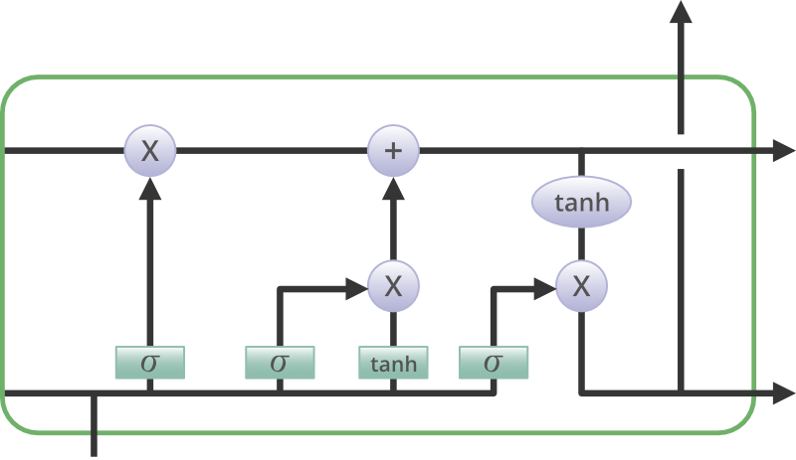
Structure Of LSTM:
It has a chain structure that contains four neural networks and different memory blocks called cells.

Slide 40
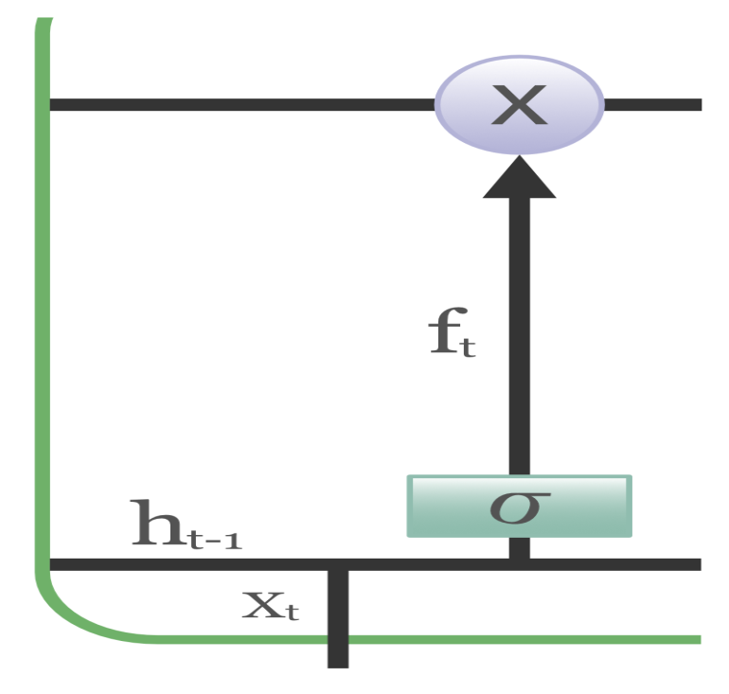
Structure Of LSTM:
Information is retained by the cells and memory manipulations are done by the gates.
There are three gates:
Forget Gate: The information that are no longer useful in the cell state is removed with the forget gate.

Slide 41
Forget Gate:
Two inputs x_t(input at particular time instant) and h_t-1(previous cell output) are fed to the gate and multiplied by the weight matrices followed by the addition of bias.
The result is passed through an activation function which gives a binary output.
For a particular cell state , if the output is 0, then that piece of information is lost and if the output is 1, then the information is retained for future use.

Slide 42
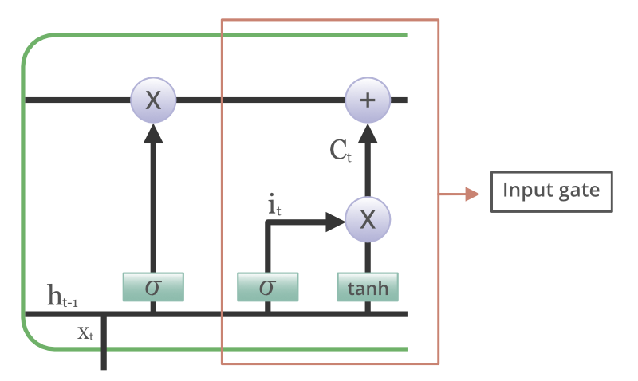
Input Gate:
We can add some useful information to the cell state using input gate.

Slide 43
Input Gate:
First , the information is regulated using the sigmoid function.
Then , filter the values to be remembered using filter gates using inputs h_t-1 and x_t.
Then , a vector is created using tanh function that gives the output from -1 to +1.
It contains all the possible values from h_t-1 and x_t.
Finally , the values of the vector and regulated values are multiplied to obtain the useful information.

Slide 44
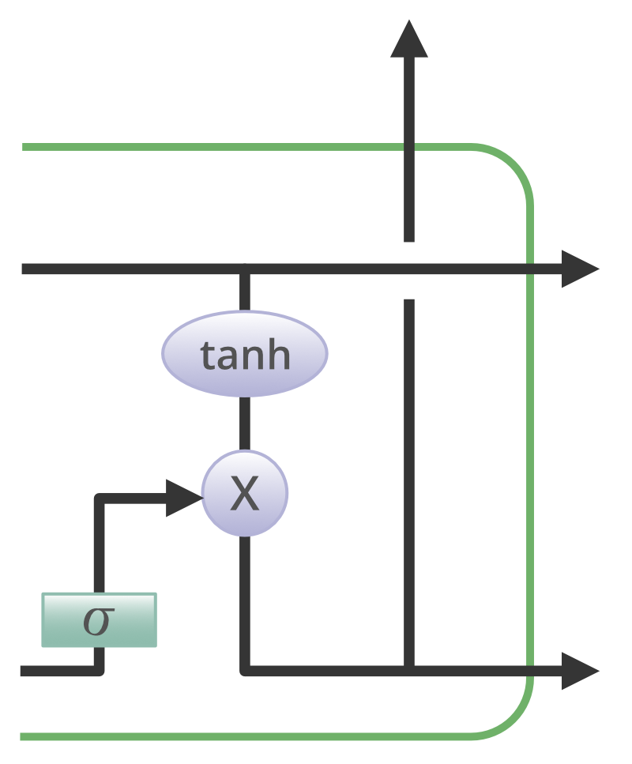
Output Gate:
Useful information can be extracted from the current cell state and presented at the output with the help of output gate.

Slide 45
Output Gate:
First , a vector is generated by applying tanh function on the cell.
Then , the information is regulated using the Sigmoid function and filter the values to be remembered using inputs h_t-1 and x_t.
Finally , the values of the vector and the regulated values are multiplied .
The result is sent as an output and input to the next cell.

Slide 46
Applications Of LSTM:
Language Modelling.
Machine Translation.
Image Captioning.
Handwriting Generation.
Question Answering Chatbots.

Slide 47
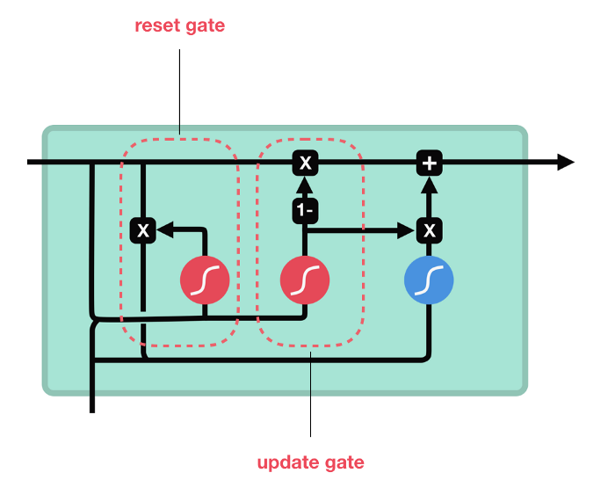
Gated Recurrent Unit(GRU)
It is the newer version of recurrent neural networks and is similar to LSTM.
GRUs has ignored the cell state and it has used the hidden state to transfer information.
It has only two gates , a reset gate and an update gate.

Slide 48
Gated Recurrent Unit(GRU)
Update Gate:
This gate acts similar to the forget and input gate of LSTM.
It decides which information to throw away and which information to add.
Reset Gate:
It is another gate used to decide how much past information to forget.
These gates have fewer tensor operations and they can be trained at a faster rate when compared to LSTM.
Researchers use both these gates to determine which one works better for their use case.

Slide 49
Natural Language Processing:
It refers to the AI method of communicating with intelligent systems using natural language like English.
When we want a smart system like robot to perform as per our instructions , then processing of Natural language is required.
NLP is nothing but making computers perform useful tasks with normal language input from the user.
The input and output of an NLP can be speech and written text.

Slide 50
Components Of NLP:
There are two major components in NLP:
Natural Language Understanding(NLU):
It involves the following tasks:
It maps the given input in natural language into useful representations.
Analyze different aspects of the language.
Natural Language Generation(NLG):
It involves the process of producing meaningful phrases and sentences in the form of natural language from some internal representation.
It involves:
Text Planning: This involves retrieving the useful content from the knowledge base.

Slide 51
Components Of NLP:
Sentence Planning:
It involves choosing the required words , forming meaningful phrases and it sets the tone of the sentence.
Text Realization:
It maps the sentence plan into the sentence structure.

Slide 52
Challenges In NLU:
NLU is very good in form and structure , but it is ambiguous.
There are various levels of ambiguity:
Lexical Ambiguity: It is at the very basic level such as the word level.
For ex, we can treat the word “board” as the noun or a verb.
Syntax level Ambiguity: A sentence can be parsed in different ways.
“She lifted the beetle with brown cap”.
Did she use cap to lift the beetle or she lifted a beetle that had brown cap.
Referential Ambiguity:
It is nothing but referring to something using pronouns.
For example , Geetha went to Kala. She said , “Iam tired”. Exactly , who is tired?

Slide 53
NLP Terminology:
Following are some of the important terms in NLP terminology.
Phonology – It is the study of organizing sound systematically.
Morphology – It is the study of construction of words from primitive meaningful units.
Syntax- The words are arranged in order to make a sentence.
Semantics- It is concerned with the meaning of words and how to combine words into meaningful phrases and sentences.
Pragmatics – It deals with using and understanding sentences in different situations.
Based on the understanding , it also tells how the interpretation of the sentence is affected.

Slide 54
NLP Terminology:
Discourse: It also deals with how the previous sentence can affect the interpretation of the next sentence.
World Knowledge: It contains the general knowledge about the world.
Steps in NLP:
Lexical Analysis:
It is used to identify and analyze the structure of words.
Lexicon is nothing but the collection of words and phrases in the language.
It divides the whole chunk of txt into paragraphs , words and sentences.

Slide 55
Steps In NLP:
Syntactic Analysis:
In this type of analysis , the words in the sentence are analyzed for grammer.
The words are arranged in such a manner that it shows the relationship between the words.
For eg , sentence such as “The bank goes to customer” is rejected by the syntactic analyzer.
Semantic Analysis:
It shows the correct meaning from the text.
The text is checked for understanding the meaning.
It is done by mapping syntactic structures and objects in the task domain.

Slide 56
Steps In NLP:
Semantic Analysis:
It disregards sentence such as “hot cool-drink”.
Discourse Integration:
The meaning of any sentence depends on the meaning of the sentence before it.
It also brings about the meaning of immediately succeeding sentence.

Slide 57
Steps In NLP:
Pragmatic Analysis:
In this , what was said is re-interpreted on what is actually meant.
It involves deriving those aspects of language which require real world knowledge.

Slide 58
NLTK Package:
Pre-Requisite:
Change in context makes it more difficult to build applications using NLP.
Context factor tells how a machine understands a particular sentence.
Hence , we need to develop Natural language applications using machine learning approaches.
To build such applications , we will use Python package called NLTK(Natural language toolkit package).

Slide 59
Importing NLTK:
NLTK can be installed with the help of following command:
pip install nltk
To build a conda package for NLTK , use the following command:
conda install -c anaconda nltk
After installing the NLTK package , we need to import it through the command prompt.
>>> import nltk

Slide 60
Downloading NLTKs Data:
After importing NLTK , we need to import the required data.
>>> nltk.download()

Slide 61
Why NLTK?
Perform large-scale analysis. Natural Language Processing helps machines automatically understand and analyze huge amounts of unstructured text data, like social media comments, customer support tickets, online reviews, news reports, and more.
Automate processes in real-time. Natural language processing tools can help machines learn to sort and route information with little to no human interaction – quickly, efficiently, accurately, and around the clock.
Tailor NLP tools to your industry. Natural language processing algorithms can be tailored to your needs and criteria, like complex, industry-specific language – even sarcasm and misused words.

Slide 62
Tokenization , Stemming and Lamentization:
Tokenization:
It is the process of breaking the given text , i.e, the character sequence into smaller units called tokens.
Tokens may be words , numbers or punctuation marks.
It is also called word segmentation.
Example:
Input − Mango, banana, pineapple and apple all are fruits.
Output −

Slide 63
Tokenization:
The process of breaking the given text can be done with the help of locating the word boundaries.
The ending of a word and starting of a new word are called word boundaries.
The writing system and the typographical structure of the words influence the boundaries.
In the NLTK module , various packages are available related to tokenization.
Packages can be used to divide the text into tokens.

Slide 64
Sent_tokenize_package:
This package will divide the input text into sentences.
Import this package with the help of following code:
from nltk.tokenize import sent_tokenize .
word_tokenize package:
This package divides the input text into words.
This package can be imported with the help of following inport statement:
from nltk.tokenize import word_tokenize .
WordPunctTokenizer package:
This package divides the input text into words as well as punctuation marks.
Following is the import statement:
from nltk.tokenize import WordPuncttokenizer

Slide 65
Stemming:
When we work with words , lot of variations occur due to grammatical reasons.
Variations means we have to deal with different forms of the same words like democratic , democracy and democratization.
Machines should understand that these different words have the same base form.
When analyzing text , it is useful to understand the base form of words.
This can be achieved by stemming.
It is the heuristic process of extracting the base form of words by chopping off the ends of words.
In NLTK module , various packages are available related to stemming.
They can be used to get the base form of words and they use various algorithms.

Slide 66
PorterStemmer package:
Python package uses porter’s algorithm to extract the base form.
Import this package with the help of following python code:
from nltk.stem.porter import PorterStemmer .
For eg , if we give the word ‘flying’ as the input to this stemmer , we will get the word ‘fly’ after stemming.
LancasterStemmer package:
This package will use the Lancaster’s algorithm to extract the base form:
Import this with the help of following code:
from nltk.stem.lancaster import LancasterStemmer .
For eg , if we give the word ‘flying’ as the input to this stemmer , we will get the word ‘fly’ after stemming.

Slide 67
Stemming:
SnowballStemmer package:
This python package will use the snowball’s algorithm to extract the base form.
This package can be imported with the help of following python code:
from nltk.stem.snowball import SnowballStemmer .
For eg , if we give the word ‘flying’ as the input to this stemmer , we will get the word ‘fly’ after stemming.
All these algorithms have varying levels of strictness.
If we compare the three stemmers , Porter stemmer is the least strict and Lancaster is the stricitest.
Snowball stemmer can be used in terms of speed as well as strictness.

Slide 68
Lemmatization:
This technique is used for extracting the base form of words.
It does this task with the help of vocabulary and morphological analysis of words.
This kind of base form of any word is called lemma.
The main difference between stemming and lemmatization is the vocabulary and morphological analysis of words.
Stemming commonly collapses derivationally related words whereas lemmatization collapses the different inflectional forms of lemma.
If we provide the word ‘saw’ as the input , then stemming will return the word ‘s’ but lemmatization will return the word either see or saw depending on whether the use of a token was a verb or noun.

Slide 69
Lemmatization:
There is a package related to lemmatization process which can be used to get the base form of word:
WordNetLemmatizer package:
This package will extract the base form of word depending on whether it is used as a noun or a verb.
T he package can be imported with the help of following import statement:
from nltk.stem import WordNetLemmatizer .

Slide 70
Bag Of Word(BoW) Model:
It is a model in NLP and it is used to extract the features from text.
Text can be used in modelling such that in machine learning algorithms.
Machine learning algorithms cannot work with raw data and they need numeric data so that they can extract meaningful information out of it.
The conversion of text data into numeric data is called feature extraction or feature encoding.

Slide 71
Working Of BoW model:
This model is used for extracting the essential features from text.
Example , consider if we have a text document and if we want to convert it to numeric data.
If we want to extract the features out of it , then this model extracts the vocabulary from all the words in the document.
By using a document term matrix , it will build a model.
BoW represents a document as a bag of words.
Information about the structure of words in the document is discarded.

Slide 72
Document Term Matrix:
It is the matrix of various word counts that occur in a matrix.
Using this matrix , text document can be represented as a weighted combination of various words.
If we set a threshold and choose the words that are more meaningful , we can build a histogram of all the words in the document that can be used as a feature vector.
Example:
We have the following two sentences:
Sentence 1 – We are using the Bag Of Words model.
Sentence 2 – Bag Of Words model is used for extracting the essential features.

Slide 73
Document Term Matrix:
Consider the two sentences , we have the following 13 distinct words:
we
are
using
the
bag
of
words
model
is
used
for
extracting
features

Slide 74
Document Term Matrix:
Build a histogram for each sentence by using the word count in each sentence:
Sentence 1 − [1,1,1,1,1,1,1,1,0,0,0,0,0]
Sentence 2 − [0,0,0,1,1,1,1,1,1,1,1,1,1]
Feature vectors have been extracted.
Each feature vector is 13-dimensional because we have 13 distinct words.

Slide 75
Concept Of Statistics:
Statistical concept is called Term Frequency -Inverse Document Frequency
(tf-idf).
Every word is important in the document.
Statistics help us in understanding the importance of each word.
Term Frequency(tf):
It is a measure of how frequently each word appears in the document.
It is obtained by dividing the count of each word divided by the total number of words in the document.

Slide 76
Concept Of Statistics:
Inverse Document Frequency(idf):
It is a measure of how unique the word is to the document in the given set of
Documents.
For calculating idf and formulating distinctive feature vector , reduce the weights of commonly occuring words like the and weigh up the rare words.

Slide 77
Building a Bag Of Words Model In NLTK:
Define a collection of strings using CountVectorizer to create vectors from these sentences.
Import the necessary package:
from sklearn.feature_extraction.text import CountVectorizer.
Define the set of sentences:
Sentences = ['We are using the Bag of Word model', 'Bag of Word model is used for extracting the features.']
vectorizer_count = CountVectorizer()
features_text = vectorizer_count .fit_transform(Sentences).todense()
print(vectorizer_count .vocabulary_)

Slide 78
Output:
The above program generates the output as shown:
It shows that we have 13 distinct words in the above two sentences:
{'we': 11, 'are': 0, 'using': 10, 'the': 8, 'bag': 1, 'of': 7, 'word': 12, 'model': 6, 'is': 5, 'used': 9, 'for': 4, 'extracting': 2, 'features': 3}.
These are the feature vectors(text to numeric form) which can be used for machine learning.

Slide 79
Category Prediction:
Words are not only important but also the category of words is also important.
We need to find in which category of text a particular word falls.
For example , we want to find out if a sentence belongs to a particular category (Eg, news, sports, dance, music etc).
In this example , we are going to use tf-idf to formulate a feature vector to find the category of documents.
Use the data from 20 newsgroup dataset of sklearn.

Slide 80
Import the Required Packages:
from sklearn.datasets import fetch_20newsgroups
from sklearn.naive_bayes import MultinomialNB
from sklearn.feature_extraction.text import TfidfTransformer
from sklearn.feature_extraction.text import CountVectorizer
Define the category map:
We are using five different categories like Religion, autos , sports , electronics and space.
category_map = {'talk.religion.misc':'Religion','rec.autos''Autos', 'rec.sport.hockey':'Hockey','sci.electronics':'Electronics', 'sci.space': 'Space'}

Slide 81
Category Prediction:
Create the training set:
training_data = fetch_20newsgroups(subset = 'train', categories = category_map.keys(), shuffle = True, random_state = 5).
Build a count vectorizer and extract the term counts:
vectorizer_count = CountVectorizer()
train_tc = vectorizer_count.fit_transform(training_data.data)
print("\nDimensions of training data:", train_tc.shape)

Slide 82
Category Prediction:
The tf-idf transformer is created as follows:
tfidf = TfidfTransformer()
train_tfidf = tfidf.fit_transform(train_tc)
Define the test data:
input_data = [ 'Discovery was a space shuttle',
'Hindu, Christian, Sikh all are religions',
'We must have to drive safely',
'Puck is a disk made of rubber',
'Television, Microwave, Refrigrated all uses electricity' ]

Slide 83
Category Prediction:
The above data will help us train a multinomial Naïve Baiye’s classifier:
classifier = MultinomialNB().fit(train_tfidf, training_data.target)
Transform the input data using count vectorizer:
input_tc = vectorizer_count.transform(input_data)
Transform the vectorized data using tfidf transformer:
input_tfidf = tfidf.transform(input_tc)
Next , predict the output categories:
predictions = classifier.predict(input_tfidf)

Slide 84
Category Prediction:
The output is generated as follows:
for sent, category in zip(input_data, predictions):
print('\nInput Data:', sent, '\n Category:', \ category_map[training_data.target_names[category]])

Slide 85
Category Prediction:
The predictor category generates the following output:
Dimensions of training data: (2755, 39297)
Input Data: Discovery was a space shuttle
Category: Space
Input Data: Hindu, Christian, Sikh all are religions
Category: Religion
Input Data: We must have to drive safely
Category: Autos
Input Data: Puck is a disk made of rubber
Category: Hockey
Input Data: Television, Microwave, Refrigrated all uses electricity Category: Electronics

Slide 86
Gender Finder:
A classifier will be trained to find the gender(male or female) by providing the names.
A heuristic is used to construct a feature vector and train the classifier.
Use the labelled data from scikit-learn package.
Import the required packages:
import random
from nltk import NaiveBayesClassifier
from nltk.classify import accuracy as nltk_accuracy
from nltk.corpus import names

Slide 87
Gender Finder:
Extract the last ‘N’ letters from input word.
Letters will act as features.
def extract_features(word, N = 2):
last_n_letters = word[-N:]
return {'feature': last_n_letters.lower()}
if __name__=='__main__':

Slide 88
Gender Finder:
Create the training data using labelled names:
male_list = [(name, 'male') for name in names.words('male.txt')] female_list = [(name, 'female') for name in names.words('female.txt')] data = (male_list + female_list)
random.seed(5)
random.shuffle(data).
Test data will be created as follows:
namesInput = ['Rajesh', 'Gaurav', 'Swati', 'Shubha']

Slide 89
Gender Finder:
Define the number of samples used to train and test with the following code:
train_sample = int(0.8 * len(data))
We need to iterate through different lengths so that accuracy can be compared:
for i in range(1, 6):
print('\nNumber of end letters:', i)
features = [(extract_features(n, i), ) for (n, gender) in data] train_data, test_data = features[:train_sample],
features[train_sample:]
classifier = NaiveBayesClassifier.train(train_data)

Slide 90
Gender Finder:
The accuracy of the classifier can be predicted as follows:
accuracy_classifier = round(100 * nltk_accuracy(classifier, test_data),2) print('Accuracy = ' + str(accuracy_classifier) + '%').
Predict the output:
for name in namesInput:
print(name, '==>', classifier.classify(extract_features(name, i)))

Slide 91
Output:
Number of end letters: 1
Accuracy = 74.7%
Rajesh -> female
Gaurav -> male
Swati -> female
Shubha -> female
Number of end letters: 2
Accuracy = 78.79%
Rajesh -> male
Gaurav -> male
Swati -> female
Shubha -> female

Slide 92
Output:
Number of end letters: 3
Accuracy = 77.22%
Rajesh -> male
Gaurav -> female
Swati -> female
Shubha -> female
Number of end letters: 4
Accuracy = 69.98%
Rajesh -> female
Gaurav -> female
Swati -> female
Shubha -> female

Slide 93
Output:
Number of end letters: 5
Accuracy = 64.63%
Rajesh -> female
Gaurav -> female
Swati -> female
Shubha -> female
Accuracy in maximum number of end letters are two and it is decreasing as the number of end letters are increasing.

Slide 94
Analysis Of Time Series Data:
From the given data , we have to predict the next value from the given input data.
This is an important concept in machine learning.
Time Series Data:
It is nothing but the data that is in a series of particular time intervals.
If we want to predict a sequence in machine learning , then we need to deal with sequential data and time.
Series data is an abstract of sequential data.
Data ordering is an important feature of sequential data.

Slide 95
Time Series Analysis Concept:
Time series analysis is used to predict the next data in the sequence based on the previously observed data.
The prediction can be anything like symbol , number , next day weather ,next day in speech.
Sequence analysis is useful for applications like stock market analysis , weather forecasting and product recommendations.

Slide 96

Example:
The following example is considered to understand the sequence predictio.
A , B, C and D are the given values and we have to predict the value E using sequence prediction model.

Slide 97
Package Installation:
For time series data analysis using python , install the following packages.
Pandas:
It is a open source python library and it contains data analytic tools for python.
Pandas can be installed with the help of following command:
pip install pandas
If you are using Anaconda , then pandas can be installed using the conda package manager.
conda install -c anaconda pandas

Slide 98
HmmLearn:
It is a ope source library.
It contains hidden algorithms and models to learn Hidden Markov Models(HMM) in python.
It can be installed with the help of following command:
pip install hmmlearn .
If we are using Anaconda , then conda package manager can be used to install this library:
conda install -c omnia hmmlearn

Slide 99
PyStruct:
It is a structured learning and prediction library.
Learning algorithms in PyStruct have names such as Conditional Random Fields(CRF) , Maximum-margin Markov Random Networks(M3N) or structural support vector machines.
It can be installed with the help of following command:
pip install pystruct

Slide 100
CVXOPT:
It is used for convex optimization based on python programming language.
It is a free software package.
It can be installed with the help of following command:
pip install cvxopt .
If we are using Anaconda , then conda package manager can be used:
conda install -c anaconda cvdoxt

Slide 101
Handling , Slicing and Extracting Statistic from Time Series Data:
Pandas is a useful tool for handling time series data.
With pandas , we can do the following:
Create a range of dates using pd.date_range package.
Pandas are indexed with dates using pd.Series package.
Perform resampling using ts.resample package.
Change the frequency.

Slide 102
Example:
The following example shows how to handle and slice time series data using pandas.
Here , we are using the Monthly Arctic Oscillation data and it can be converted to text format for our use.
Handling Time Series Data:
Import the required packages:
import numpy as np
import matplotlib.pyplot as plt
import pandas as pd

Slide 103
Handling Time Series Data:
Next , a function is defined to read the data from the input file:
def read_data(input_file):
input_data = np.loadtxt(input_file, delimiter = None)
Convert this data to time series:
Create the range of dates of the time series.
In this example , we keep one month as the frequency of data.
File is having the data which starts from Jan 1950.
dates = pd.date_range('1950-01', periods = input_data.shape[0], freq = 'M')

Slide 104
Handling Time Series Data:
In this step , time series data is created with the help of pandas series.
output = pd.Series(input_data[:, index], index = dates)
return output
if __name__=='__main__':
Enter the path of the input file:
input_file = “E:/AO.txt“
Convert the column to time series format:
timeseries = read_data(input_file)

Slide 105
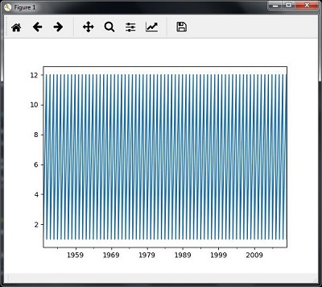
Handling Time Series Data:
Finally , plot and visualize the data , using the commands:
plt.figure()
timeseries.plot()
plt.show().

Slide 106
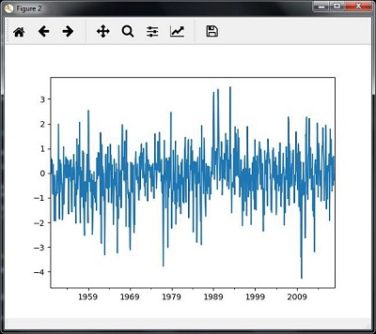
Output:

Slide 107
Slicing Time Series Data:
Slicing involves retrieving only a part of the time series data.
Data is sliced only from 1980 to 1990.
The following code is used to perform this task.
timeseries['1980':'1990'].plot()
<matplotlib.axes._subplots.AxesSubplot at 0xa0e4b00>
plt.show()

Slide 108
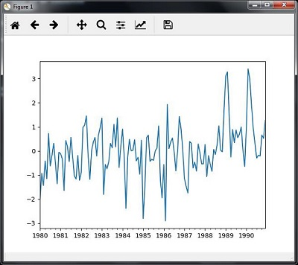
Output:

Slide 109
Extracting Statistic From Time Series Data:
If we want to make some decisions , we need to extract statistics from the given data.
Mean , variance , correlation, maximum value and minimum value are some of the statistics.
Mean:
Mean() function can be used for finding the mean.
timeseries.mean()
Output:
-0.11143128165238671

Slide 110
Maximum:
Max() function can be used for finding the maximum:
timeseries.max().
Output:
3.4952999999999999
Minimum:
Min() function can be used for finding the minimum value.
timeseries.min()
Output:
-4.2656999999999998

Slide 111
Getting Everything At Once:
In order to calculate all the statistics at a time , we can use the describe() function.
timeseries.describe().
Output:
count 817.000000
mean -0.111431 std 1.003151
min -4.265700
25% -0.649430
50% -0.042744
75% 0.475720
max 3.495300
dtype: float64

Slide 112
Re-Sampling:
Data can be resampled to a different time frequency.
Two parameters are required for resampling.
Time Period
Method.
Re-Sampling with Mean():
Following code can be used to resample the data with mean() method.
timeseries_mm = timeseries.resample("A").mean() timeseries_mm.plot(style = 'g--')
plt.show()

Slide 113
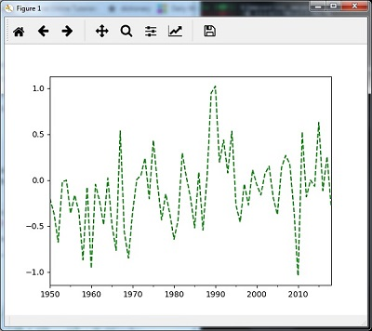
Output:

Slide 114
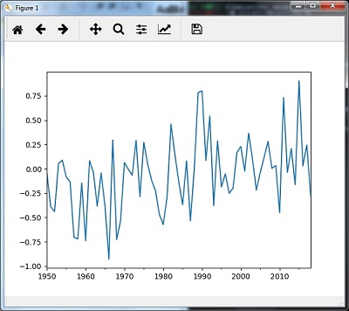
Re-Sampling With Median:
Following code can be used to resample the data using median() method:
timeseries_mm = timeseries.resample("A").median() timeseries_mm.plot()
plt.show()
Output:

Slide 115
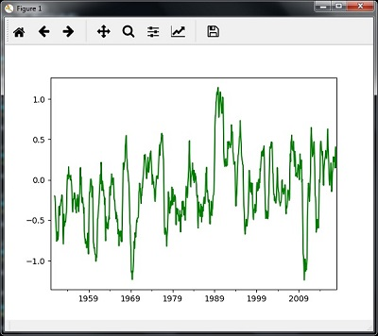
Rolling Mean:
Following code can be used to calculate the rolling mean.
timeseries.rolling(window = 12, center = False).mean().plot(style = '-g') plt.show().
Output:

Slide 116
Sequential Data Analysis By Hidden Markov Model(HMM):
It is a statistical model and it is widely used for handling continuous data.
It can be used for data such as time series Stock Market Analysis , health checkup and speech recognition.
In the following section , sequential data is analyzed using Hidden Markov Model(HMM).
Hidden Markov Model(HMM):
It is a stochastic model and it is built on the concept of Markov Chain.
It is based on the assumption that probability of the future statistics depends only on the current state rather than on any state that preceded it.
For example , when tossing a coin , we cannot say that the probability of the fifth toss will be a tail .
This is because coin does not have any memory and the next result does not depend on the previous result.

Slide 117
Sequential Data Analysis By Hidden Markov Model(HMM):
HMM consists of the following variables:
States(S): It is a set of hidden states present in a HMM.
It is denoted by S.
Output Symbols(O):
It is the set of all possible output symbols present in HMM.
It is denoted by O.
State Transition Probabilty Matrix:
It is the probability of making a transition from one state to other state.
It is denoted by A.

Slide 118
Sequential Data Analysis By Hidden Markov Model(HMM):
Observation Emission Probability Matrix(B):
It is the probability of observing the symbol at a particular state.
It is denoted by B.
Prior Probability Matrix:
It is the probability of starting at a particular state from various states of the system.
It is denoted by Π.
HMM may be defined as : 𝝀 = (S,O,A,B,𝝅)
Where,
S = {s1,s2,…sN}, is a set of N possible states,
O = {o₁,o₂,…,o_{M}} , is a set of M possible observation symbols,
A is an NxN state transition probability matrix

Slide 119
Sequential Data Analysis By Hidden Markov Model(HMM):
B is an N𝒙M observation or Emission Probability Matrix (EPM),
π is an N dimensional initial state probability distribution vector.

Slide 120
Example: Stock Market Data Analysis:
Import the required packages:
import datetime
import warnings
The Stock market data is taken from matplotlib.finance package
import numpy as np
from matplotlib import cm, pyplot as plt
from matplotlib.dates import YearLocator, MonthLocator
try:
from matplotlib.finance import quotes_historical_yahoo_och1
except ImportError:
from matplotlib.finance import ( quotes_historical_yahoo as quotes_historical_yahoo_och1)
from hmmlearn.hmm import GaussianHMM

Slide 121
Example: Stock Market Data Analysis:
Load the data from start date and end date, i.e between two specific dates
start_date = datetime.date(1995, 10, 10)
end_date = datetime.date(2015, 4, 25)
quotes = quotes_historical_yahoo_och1('INTC', start_date, end_date)
In the next step , extract the closing quotes:
closing_quotes = np.array([quote[2] for quote in quotes])
Then , extract the volume of shares traded everyday:
volumes = np.array([quote[5] for quote in quotes])[1:]

Slide 122
Example: Stock Market Data Analysis:
Take the percentage difference of closing stock prices using the following code:
diff_percentages = 100.0 * np.diff(closing_quotes) / closing_quotes[:-] dates = np.array([quote[0] for quote in quotes], dtype = np.int)[1:] training_data = np.column_stack([diff_percentages, volumes])
In this step , create and train the Guassian HMM:
hmm = GaussianHMM(n_components = 7, covariance_type = 'diag', n_iter = 1000)
with warnings.catch_warnings():
warnings.simplefilter('ignore')
hmm.fit(training_data)

Slide 123
Example: Stock Market Data Analysis:
Generate Data using HMM Model:
num_samples = 300
samples, _ = hmm.sample(num_samples).
In the final step , plot and visualize the difference percentage and volume of shares traded as output in the form of graph:
plt.figure()
plt.title('Difference percentages')
plt.plot(np.arange(num_samples), samples[:, 0], c = 'black')

Slide 124
Example: Stock Market Data Analysis:
The following code is used to visualize the volume of shares traded:
plt.figure()
plt.title('Volume of shares')
plt.plot(np.arange(num_samples), samples[:, 1], c = 'black') plt.ylim(ymin = 0)
plt.show()

Slide 125


